Slide 1
Azure Kubernetes Service
Workshop
Kamil Mrzygłód, Microsoft, 2020

Slide 2

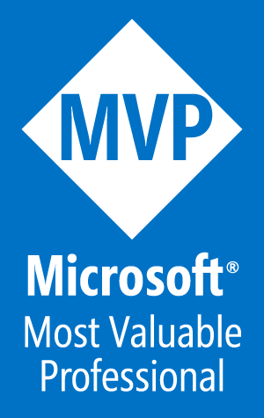
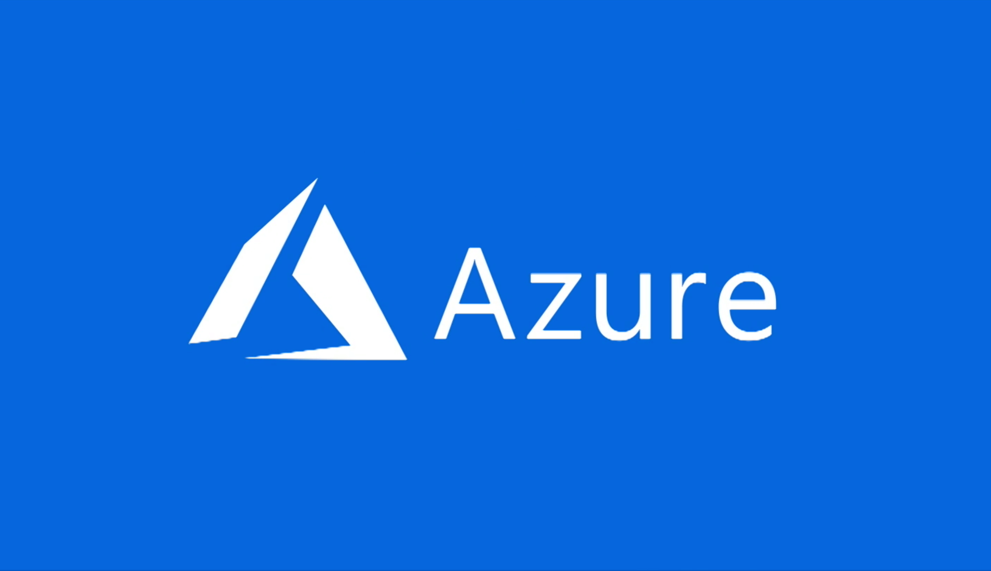



Slide 3

Menu
08:30 – 09:00 | Rejestracja
09:00 – 09:30 | Wprowadzenie do Kubernetes & Docker
09:30 – 12:30 | Konfiguracja środowiska Wdrażanie zasobów platformy Azure za pomocą ARM Konfigurowanie środowiska lokalnego za pomocą rejestru Azure Container Registry Konfigurowanie AKS z ACR Włączanie Azure Dev Spaces
12:30 – 13:00 | Lunch
13:00 – 16:00 | Wdrażanie usług Helm vs Kustomize Łączenie aplikacji front-end i back-end Różne ingress points Zabezpieczanie usług za pomocą Let's Encrypt Monitorowanie i skalowanie w AKS CI/CD z Azure Dev Ops

Slide 4
https://www.microsoftazurepass.com/

Slide 5
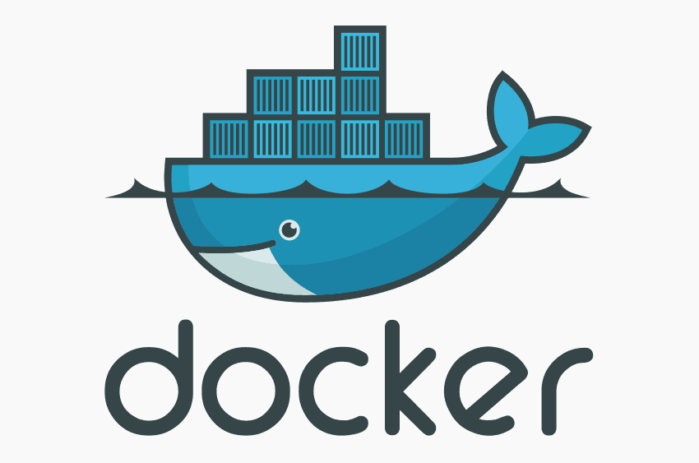
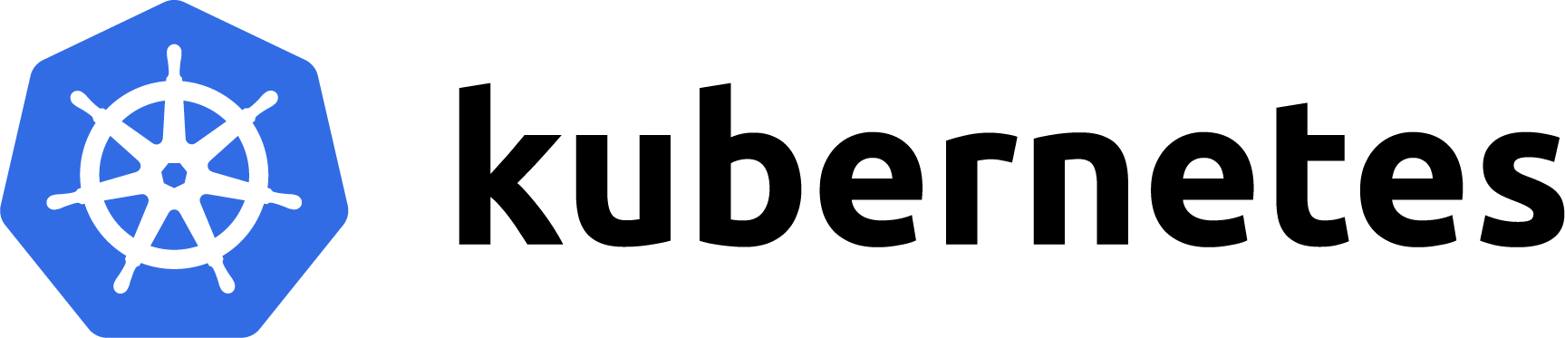
Kubernetes & Docker
Wprowadzenie

Slide 6
What is Docker?

Slide 7
Docker is a virtual machine!

Slide 8
Docker is a virtual machine!

Slide 9
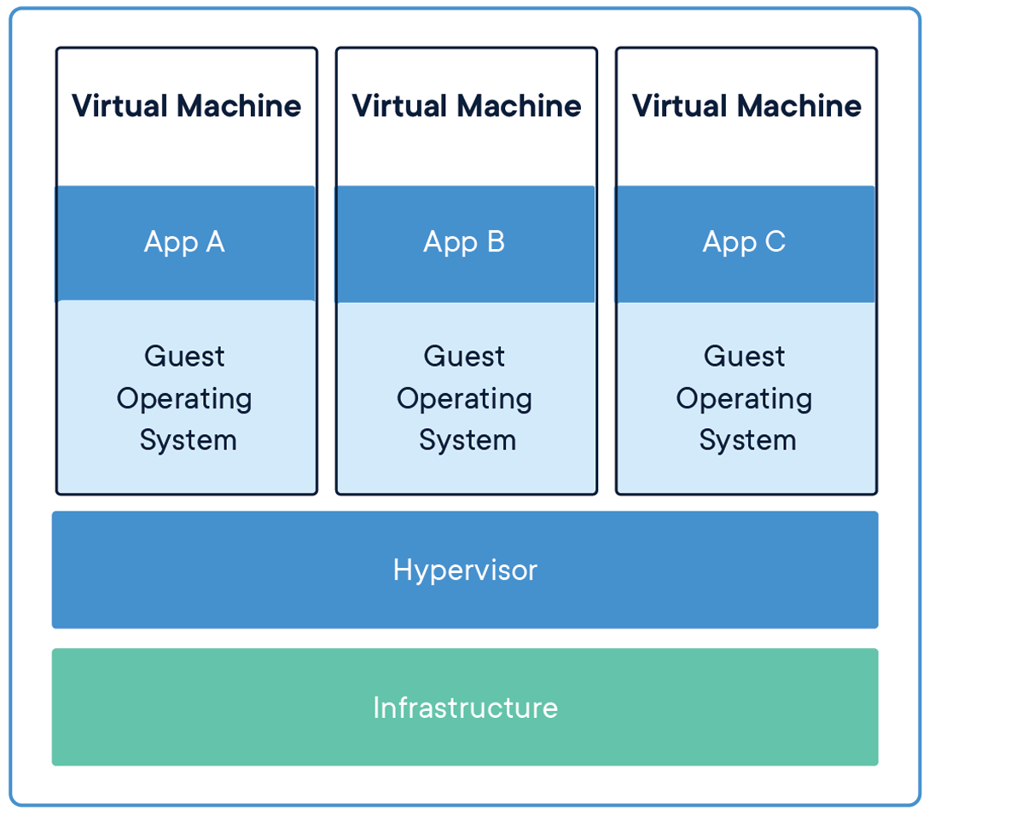

Slide 10
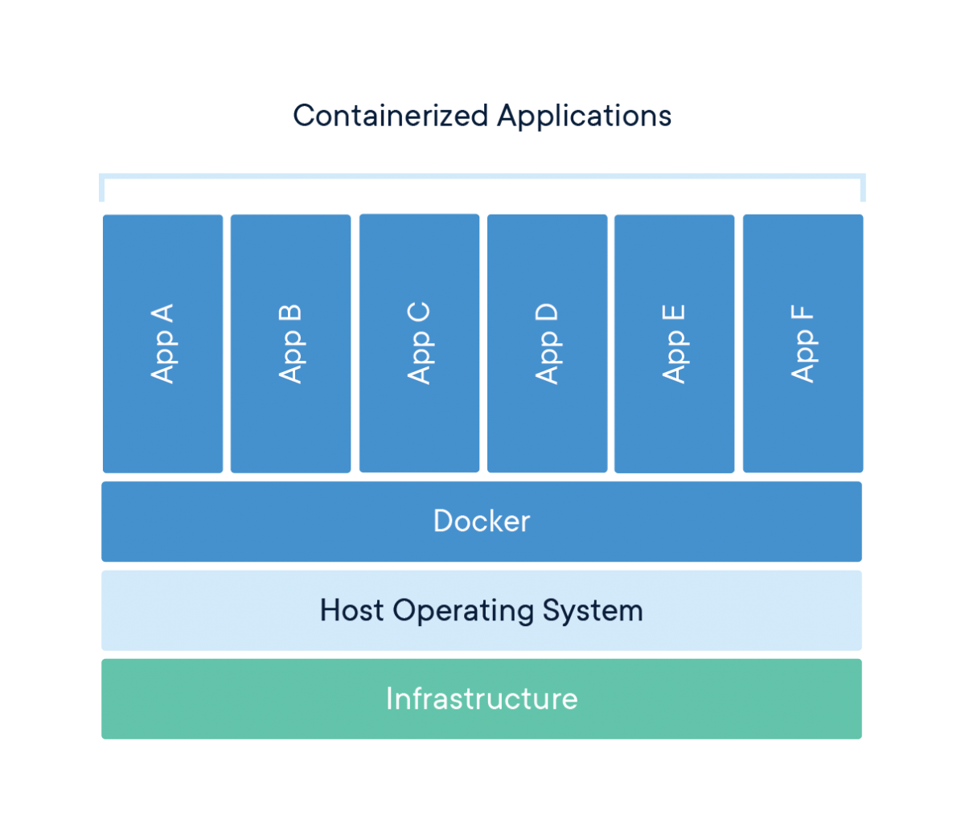

Slide 11
Comparison
Container
Virtual Machine
Abstraction at the app layer
Multiple containers can run on the same machine
Each container is an isolated proces in user space
Takes less space than VM(in general)
Abstraction of physical hardware
Runs on hypervisor to run multiple VMs on a single machine
Each VM is a full copy of an operating system, so it contains all the binaries and libraries required to run it

Slide 12
What is Kubernetes?

Slide 13
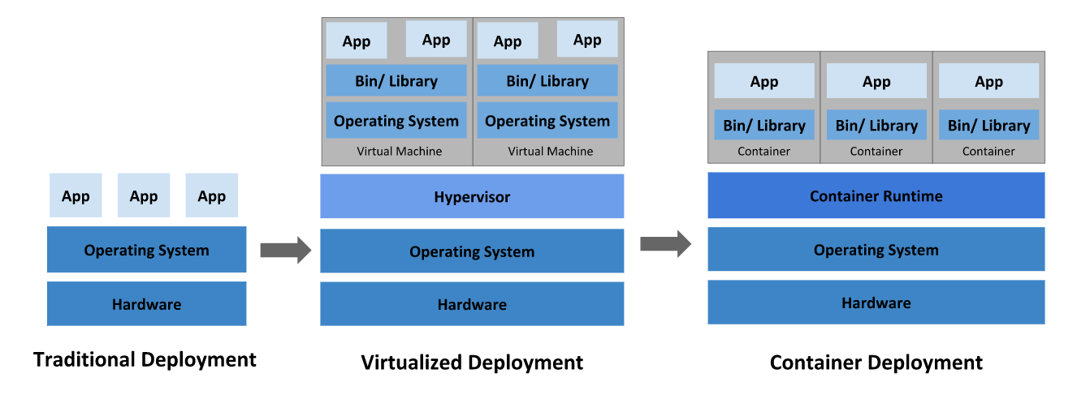
https://kubernetes.io/docs/concepts/overview/what-is-kubernetes/

Slide 14
What does container give you?
Agile application creation and deployment: increased ease and efficiency of container image creation compared to VM image use.
Continuous development, integration, and deployment: provides for reliable and frequent container image build and deployment with quick and easy rollbacks (due to image immutability).
Dev and Ops separation of concerns: create application container images at build/release time rather than deployment time, thereby decoupling applications from infrastructure.
Observability not only surfaces OS-level information and metrics, but also application health and other signals.
Environmental consistency across development, testing, and production: Runs the same on a laptop as it does in the cloud.
Cloud and OS distribution portability: Runs on Ubuntu, RHEL, CoreOS, on-prem, managed k8s installation, and anywhere else.
Application-centric management: Raises the level of abstraction from running an OS on virtual hardware to running an application on an OS using logical resources.
Loosely coupled, distributed, elastic, liberated micro-services: applications are broken into smaller, independent pieces and can be deployed and managed dynamically – not a monolithic stack running on one big single-purpose machine.
Resource isolation: predictable application performance.
Resource utilization: high efficiency and density.
https://kubernetes.io/docs/concepts/overview/what-is-kubernetes/

Slide 15
What does Kubernetes provide?
Service discovery and load balancing Kubernetes can expose a container using the DNS name or using their own IP address. If traffic to a container is high, Kubernetes is able to load balance and distribute the network traffic so that the deployment is stable.
Storage orchestration Kubernetes allows you to automatically mount a storage system of your choice, such as local storages, public cloud providers, and more.
Automated rollouts and rollbacks You can describe the desired state for your deployed containers using Kubernetes, and it can change the actual state to the desired state at a controlled rate. For example, you can automate Kubernetes to create new containers for your deployment, remove existing containers and adopt all their resources to the new container.
Automatic bin packing You provide Kubernetes with a cluster of nodes that it can use to run containerized tasks. You tell Kubernetes how much CPU and memory (RAM) each container needs. Kubernetes can fit containers onto your nodes to make the best use of your resources.
Self-healing Kubernetes restarts containers that fail, replaces containers, kills containers that don’t respond to your user-defined health check, and doesn’t advertise them to clients until they are ready to serve.
Secret and configuration management Kubernetes lets you store and manage sensitive information, such as passwords, OAuth tokens, and SSH keys. You can deploy and update secrets and application configuration without rebuilding your container images, and without exposing secrets in your stack configuration.
https://kubernetes.io/docs/concepts/overview/what-is-kubernetes/

Slide 16
What is not Kubernetes?
Does not limit the types of applications supported. Kubernetes aims to support an extremely diverse variety of workloads, including stateless, stateful, and data-processing workloads. If an application can run in a container, it should run great on Kubernetes.
Does not deploy source code and does not build your application. Continuous Integration, Delivery, and Deployment (CI/CD) workflows are determined by organization cultures and preferences as well as technical requirements.
Does not provide application-level services, such as middleware (for example, message buses), data-processing frameworks (for example, Spark), databases (for example, MySQL), caches, nor cluster storage systems (for example, Ceph) as built-in services. Such components can run on Kubernetes, and/or can be accessed by applications running on Kubernetes through portable mechanisms, such as the Open Service Broker.
Does not dictate logging, monitoring, or alerting solutions. It provides some integrations as proof of concept, and mechanisms to collect and export metrics.
Does not provide nor mandate a configuration language/system (for example, Jsonnet). It provides a declarative API that may be targeted by arbitrary forms of declarative specifications.
Does not provide nor adopt any comprehensive machine configuration, maintenance, management, or self-healing systems.
Additionally, Kubernetes is not a mere orchestration system. In fact, it eliminates the need for orchestration. The technical definition of orchestration is execution of a defined workflow: first do A, then B, then C. In contrast, Kubernetes comprises a set of independent, composable control processes that continuously drive the current state towards the provided desired state. It shouldn’t matter how you get from A to C. Centralized control is also not required. This results in a system that is easier to use and more powerful, robust, resilient, and extensible.
https://kubernetes.io/docs/concepts/overview/what-is-kubernetes/

Slide 17

http://bit.ly/K8s2402

Slide 18
Thank you! @Kamil_Mrzyglod kamil@thecloudtheory.com https://github.com/TheCloudTheory/Presentations

